Slide 1
CVL Transformation
Complex Track Works Summary
Cardiff Queen St, Cardiff Bay and Pontypridd Station

Slide 2
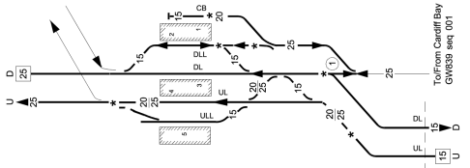
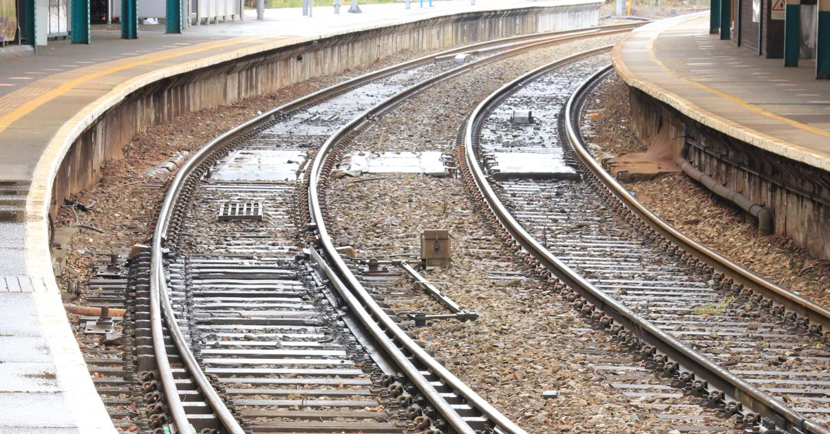
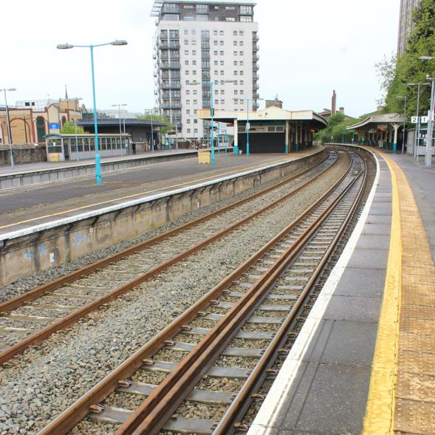
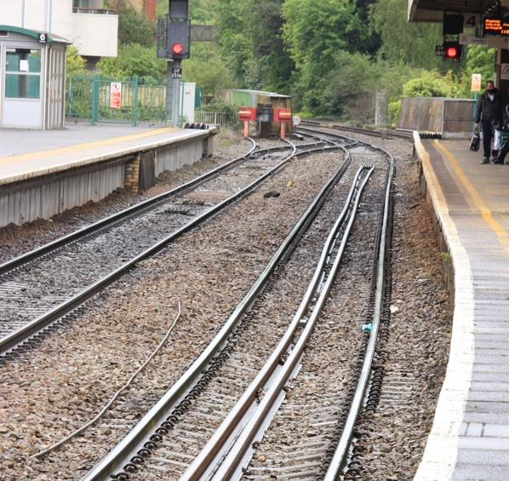
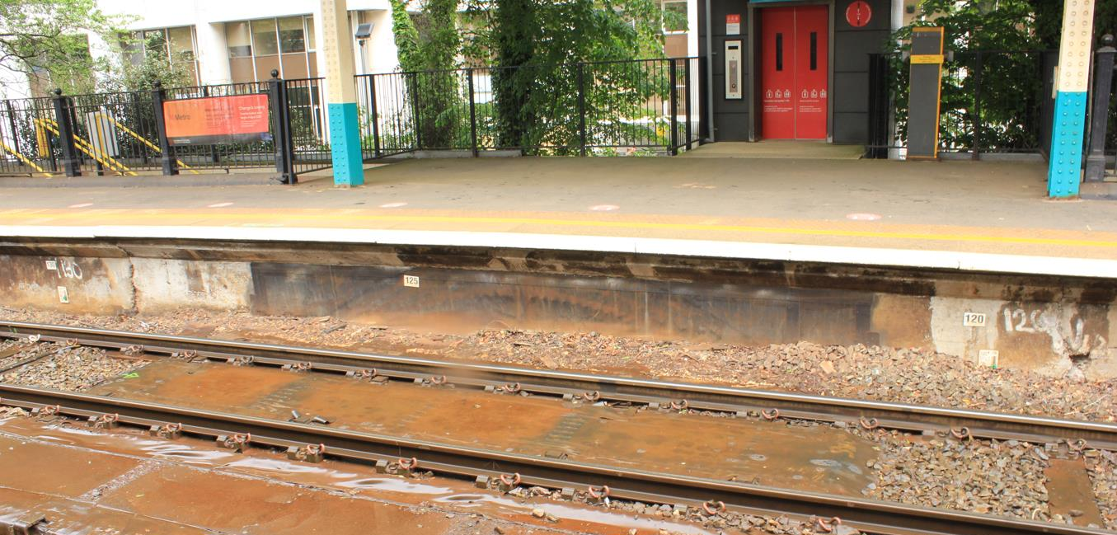
Cardiff Queen Street Station – Existing Layout
3
3
4
1
2
1
2
4

Slide 3

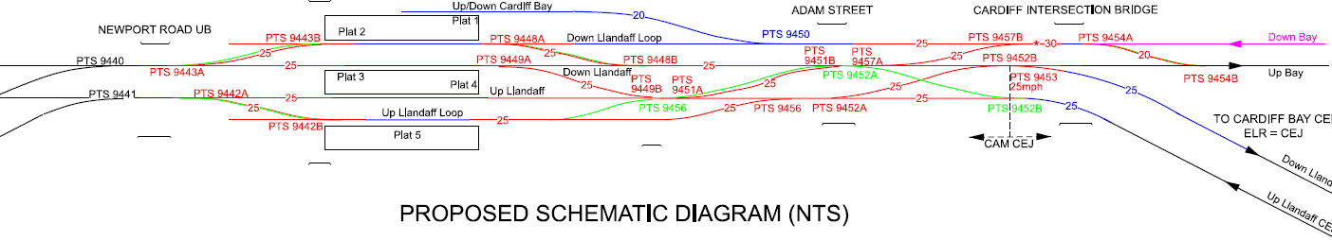
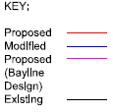
Cardiff Queen St - Current and Proposed Layout
Existing Layout
Proposed Layout
4
5
15
3
7
6
10
14
13
16
1
8
9
11
12
2

Slide 4
Cardiff Queen St – Enabling and Blockade Works
Enabling Stages 2026:
WK12 (2026) – 20/06/26 (27hrs) – Component renewal for longitudinal bearers at Queen Street passenger subway
Main CAR Blockade 2027:
WK01 to WK04 – 01/04/27 to 22/04/27 (25 days)
16 x S&C point ends
Civils level boarding works on Platforms 2, 3, 4 & 5
Waterproofing on Guildford Crescent U/B
Upgrade/Modify 3 x buffer stops
22 x SCO Trains planned
2 x S&C Tampers for 24hrs
2 x Kirow 250 Crane required (Fri 2nd April to Sunday 11th April – 9 days on site)
Total approx. 1,810m linear track renewal length:
Up Llandaff Loop = approx. 380m. Up Llandaff = approx. 460m. Down Llandaff = approx. 640m. Down Llandaff Loop = approx. 330m
Fully welded and stressed on hand back (26 x stresses planned in blockade)

Slide 5
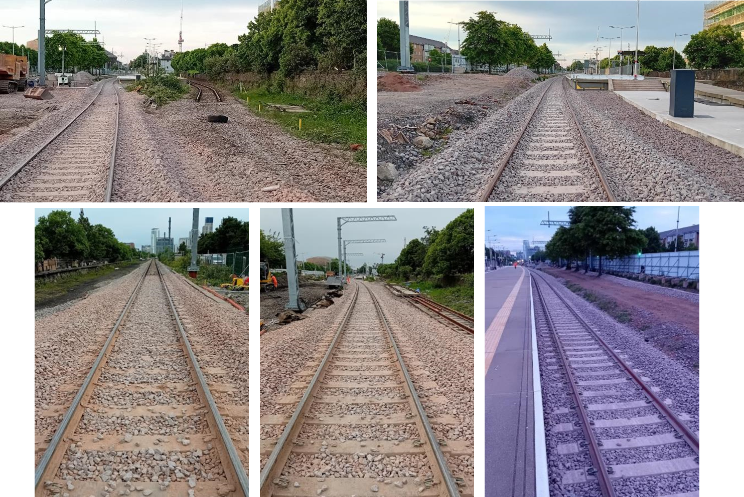
Cardiff Bay Line – Existing Layout

Slide 6
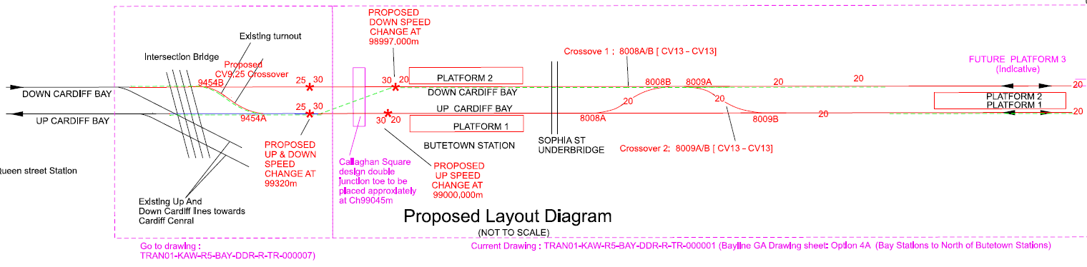


Cardiff Bay Line - Proposed Layout
9454a
9454b

Slide 7
Cardiff Bay Line – Enabling and Blockade Works
Enabling Stages 2026:
WK12 (2026) – 20/06/26 (27hrs) – 60m Plt1 tie into 8009B
WK30-31 (2026) – 24/10/26 to 31/10/26 (7 days) – 8008pts and 8009pts (installed as Plain Line). New UM – Rail drop required prior (2x 216m rails, 8 x 108 rails, Planned Wk20)
Main Works (pre-CAR Blockade) 2027:
WK52 – 22/03/27 to 26/03/27 – Main blockade works prior to CAR commissioning:
Install switch rails to 8008a/b and 8009a/b points (installed on plain line base plates initially in earlier stage in 2026)
Final slew and connection of new Down Main off back of 9454a points
Complete Up Main and 1 x panel length at Signal CF2872
99030m to 99220m = 190m of Single line cut, slewed and then installed as Up Main and Down Main operation
7 x SCO Trains required
1 x S&C Tamper for 16hrs required
2 x stresses and site welded for hand back

Slide 8
Pontypridd Station
Main Works – Week 19 & 20 August 2026 Blockade (9 Days):
Track
Plt 2 Down Main – 390m renewal. 250mm dig with geo. New CEN56 rail. New EG47 concretes. 500 LRP’s to install. 115 sleepers with under sleeper pads required.
Plt 3 Up Main - 270m renewal. 250mm dig with geo. New CEN56 rail. New EG47 concretes. 370 LRP’s to install.
Civils Level Boarding
Plat 2 - Circa 30m of coper adjustments

Slide 9
Haulage Schedule
Year | Wk | Pd | Site Location | No. of Trains | No. of Locos | Falcons (180) | Hawks (50) | Autos (40) | Sidetipper (15) | Osprey (18) | Salmon (20) | RDT | Tamper - Core | Tamper - FUT | Site yardage | No of rails | Long Rail (216m) 56E1 | Total CWR | Ballast (Tonnes) | Type 1 (Tonnes) | Spoil | G44 Concrete Sleepers | EG47 Concrete Sleepers
2026-27 | 19 | 5 | Pontypridd Track Renewal and LB | 8 | 16 | 56 | 0 | 30 | 0 | 4 | 3 |  |  |  |  | 0.0 |  | 0 | 4320 |  | 2460 | 0
2026-27 | 20 | 5 | Pontypridd Track Renewal and LB | 2 | 4 | 0 | 0 | 0 | 0 | 0 | 0 |  | 2 |  |  | 0.0 |  | 0 | 0 |  | 0 | 0
2026-27 | 20 | 5 | Cardiff Bay (Rail Drop) | 1 | 2 | 0 | 0 | 0 | 0 | 0 | 0 | 1 | 1 |  |  | 6.0 | 1296 | 1296 | 0 |  | 0 | 0
2026-27 | 22 | 6 | Pontypridd Track Renewal and LB |  |  | 0 | 0 | 0 | 0 | 0 | 0 |  |  | 1 |  | 0.0 |  | 0 | 0 |  | 0 | 0
2026-27 | 30 | 8 | Cardiff Bay Up Main | 4 | 4 | 40 | 5 | 0 | 0 | 0 | 0 |  |  | 1 |  | 0.0 |  | 0 | 0 |  | 0 | 0
2026-27 | 51/52 | 13 | Cardiff Bay Re-doubling | 7 | 7 | 54 | 7 | 0 | 0 | 0 | 5 |  |  |  |  | 0.0 |  | 0 | 0 |  | 0 | 0
 |  |  |  |  | 34 | 167 | 12 | 30 | 0 | 4 | 9 | 1 |  |  |  |  | 1296 | 1296 | 4740 | 0 | 2880 | 0 | 112
Exact Volumes TBC for Cardiff Queen St Blockade Works (Total of 22 Trains, 2 Tampers)

Slide 10
Access Schedule

